Slide 1
AI for Kids
UK Robotics Week 2024

Slide 2
This Story is about my story is about two superhero girls sisters Zena 8 years old Hannah 5 years old they are using generative AI in everyday to become better if use it efficiently and ethically
This story is created by:
Xeinah
Hanah
Manal

Slide 3
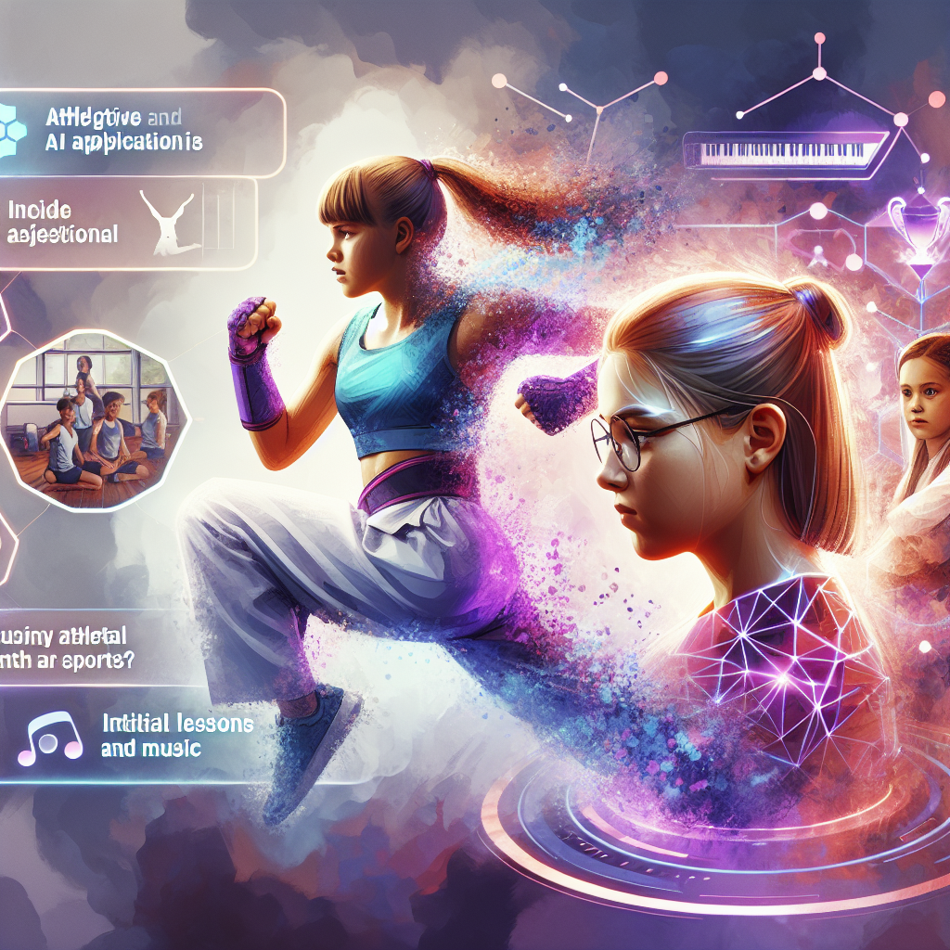
1. The superhero starts his day using generative AI to plan healthy breakfast, school activities, and engage with others. 2. The superhero also uses generative AI to study history and ancient civilizations effectively. 3. As the superhero progresses to university, he delves into comparative history studies. 4. Upon graduating, the superhero considers a good historical question for a Ph.D. in archaeology. 5. In another story, a primary school girl is interested in using generative AI to learn geography. 6. The superhero in that story effectively uses generative AI for various tasks, including school projects and leisure advice. 7. Transitioning
to university, the superhero focuses on geography studies with the help of generative AI. 8. The superhero further pursues a Ph.D. in geography with the support of generative AI suggestions. 9. Another story introduces two young sisters, Zana and Hannah, who are yet to explore generative AI. 10. Zana utilizes generative AI to improve her karate skills while exploring other sports suitable for Hannah's age. 11. The family's diverse professional backgrounds prompt a consideration of paths into the generative AI field. 12. For Hannah's development in both music and sports, generative AI could play a role in her learning journey.
An energetic and strong depiction of a young girl named Xena, demonstrating her karate moves. She is using a virtual assistant that uses generative AI technology to guide her through new techniques and strategies. Nearby, another young girl named Hannah is seen showing a lack of interest in sports. The objective here is to inspire her towards athletic and musical pursuits. Can there be a scene involving intelligent AI applications providing her initial lessons in both sports and music?

Slide 4
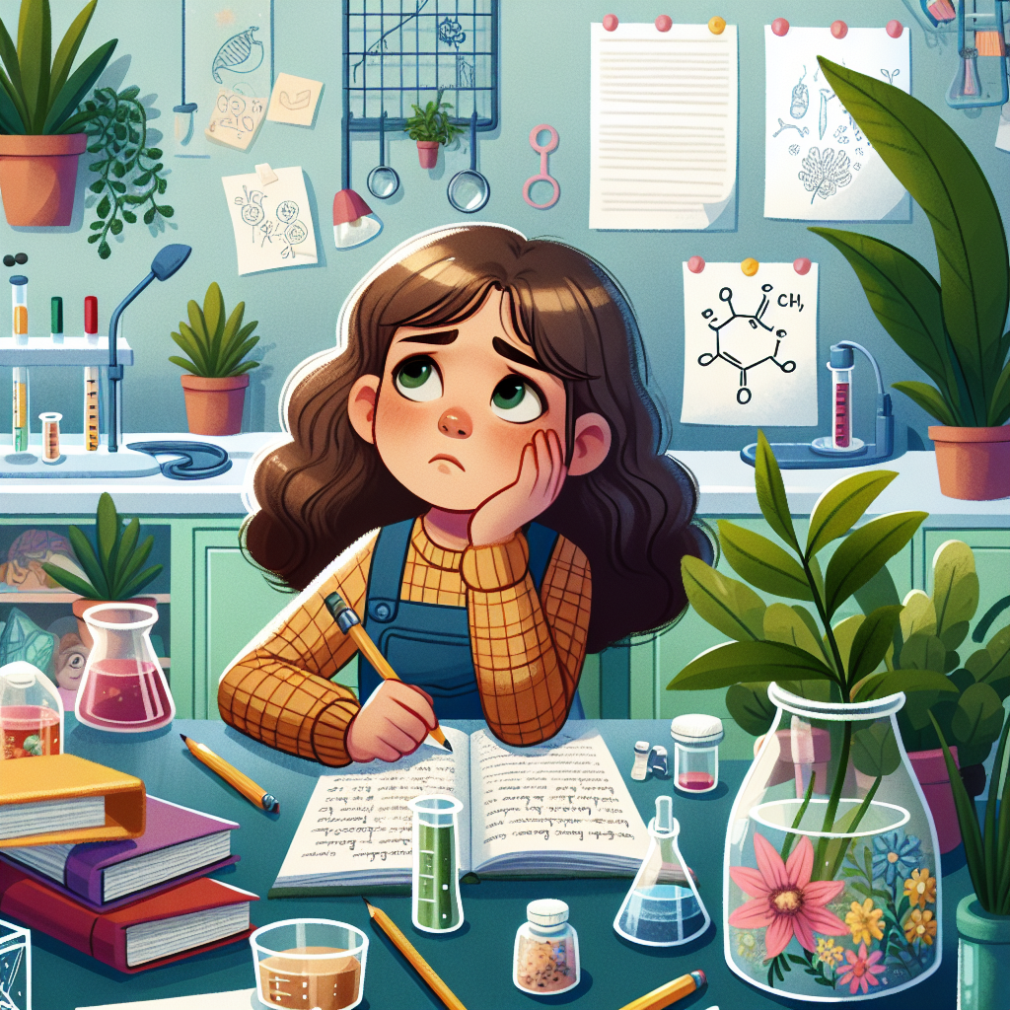
children_story_book_2_1.pptx: The superhero starts the day with generative AI for a healthy breakfast, plans school activities, engages with teachers, and advises family on leisure. children_story_book_3.pptx: The superhero uses generative AI for breakfast, school planning, studying, and family advice. children_story_book_4.pptx: The superhero uses generative AI for breakfast, school planning, studying,
homework, and family advice. children_story_book_7.pptx: The superhero uses generative AI for geography studies in school, university, and PhD research. children_story_book_10.pptx: Introducing generative AI to Zana and Hannah for sports, music, and career decisions. children_story_book_12.pptx: Xena uses generative AI for karate, while Hannah explores sports and music with potential AI assistance.
Imagine an illustrated children's story book featuring an 8-year-old girl who is caught in a dilemma. She is trying to decide whether she wants to follow the path of her grandmother, a prominent ecologist, or whether she wants to pursue a career as a medical doctor or an engineer. She sits in her room, surrounded by textbooks and notes, her eyes reflecting her inner struggle. The room is a mix of lush green plants, a nod to her grandmother's profession, medical equipment and engineering tools. Portray this scene in a colorful, friendly, and engaging style, suitable for a children's book.

Slide 5
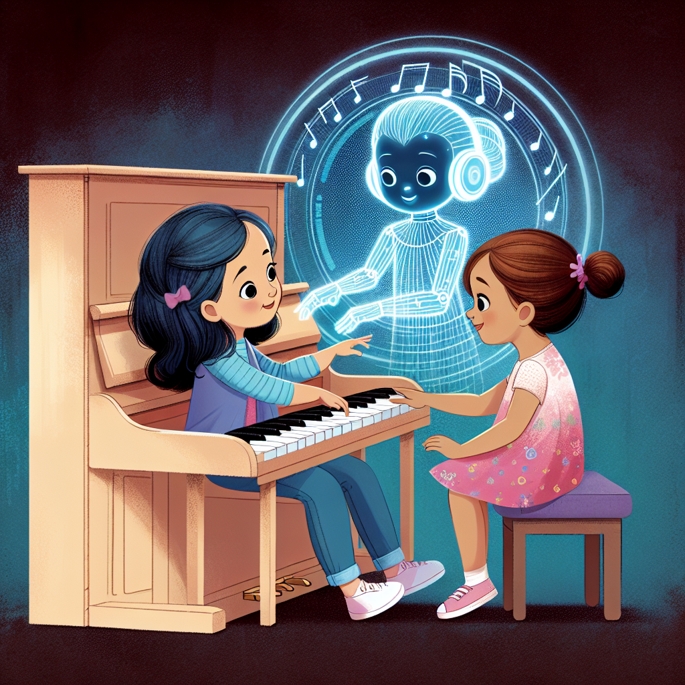
Children's Story Book 2.1: The superhero begins their day by using generative AI to help with tasks from planning breakfast to engaging with teachers and studying. They also assist their family in planning leisure activities. Children's Story Book 3: The superhero continues to rely on generative AI for tasks like planning breakfast, engaging at school, and advising family on leisure. They begin showing interest in history and using AI for learning. Children's Story Book 4: The superhero utilizes generative AI for various tasks, including studying history, engaging with AI in solving homework, and advising family. As they progress through education, they explore more topics, such as archaeology and monuments, with AI's help. Children's Story
Book 7: A primary school kid superhero delves into geography using generative AI for learning and homework. They progress to university, tackling more advanced geography topics and even pursuing a PhD with AI support. Children's Story Book 10: Sisters Zana and Hannah embark on their superhero journeys. Zana uses generative AI for learning karate moves, while the focus turns to introducing sports and music to Hannah, exploring how AI can assist their development. Children's Story Book 12: The sisters continue their adventures, with Zana using AI for karate and Hannah starting to explore sports and music. Important decisions loom, such as Zayna's career path and Hannah's learning journey with the help of generative AI.
An illustration for a children's story book depicting two girls, Hannah and Zayna, around 5 years old. They are both eager to learn new things and are sitting by an open piano, tentatively touching the keys. An ethereal AI hologram is illustrating the keys to press on the piano, aiding them in their learning journey with patient guidance.

Slide 6
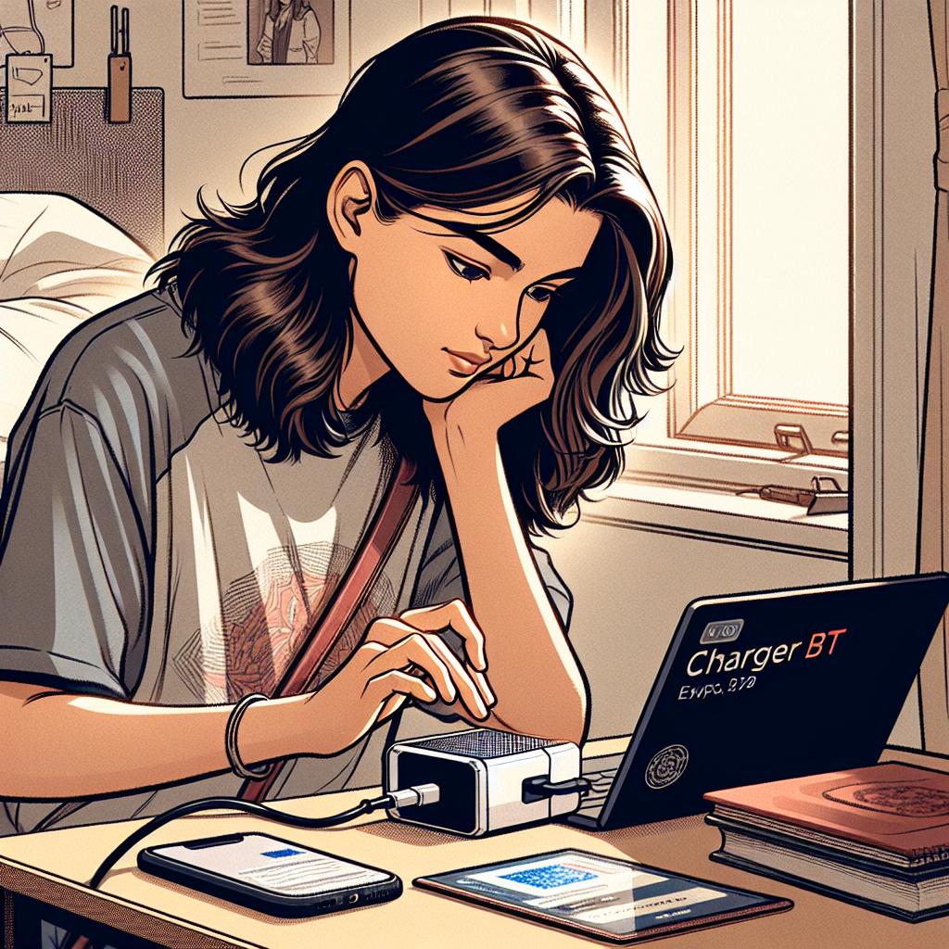
Children's Story Book 2.1: The superhero starts the day by using generative AI for planning and having a healthy breakfast before school. He engages with teachers, studies, and advises family on leisure activities. Children's Story Book 3: The superhero uses generative AI for meal planning, school routines, and family time. He also shows interest in learning history and utilizing generative AI efficiently. Children's Story Book 4: The superhero uses generative AI for various activities, including studying history and engaging with reinforcement learning algorithms. He continues his education in university exploring historical topics. Children's Story
Book 7: A primary school girl superhero is keen on geography and utilizing generative AI ethically. She uses AI for schoolwork, studying, and answering questions in geography. Children's Story Book 10: The superhero sisters, Zana and Hannah, start exploring generative AI for learning new skills in sports, music, and academics. They contemplate future career paths related to generative AI. Children's Story Book 12: The sisters continue to use generative AI for improving their skills and learning new subjects. They consider potential career paths in fields like medicine, engineering, and music with the help of AI.
Illustrate a scene of a young woman, named Zeyna, who is an engineering student at a university in Cairo, Egypt. She is engrossed in learning programming. Show her using a device called Charger BT to aid her studies. Detail her work setup in her dorm room or library, focusing on the Charger BT device and how it might help enhance her learning experience. Capture her concentration and determination to learn better using technology.

Slide 7
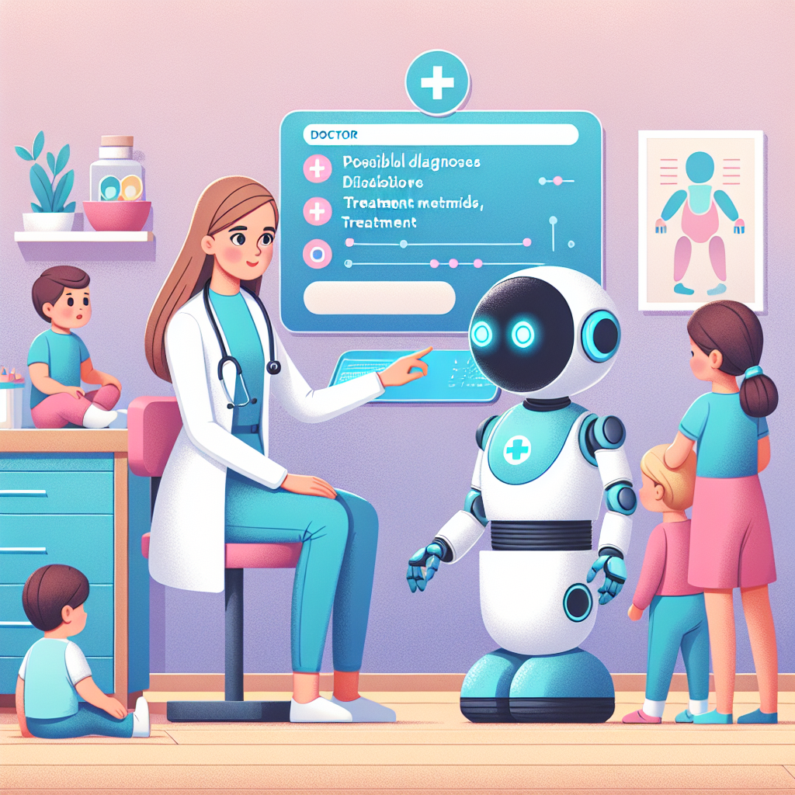
Once upon a time, a superhero used generative AI in planning, studying, and advising family on leisure activities. The superhero became interested in learning history and mastering reinforcement learning algorithms with generative AI. The superhero used generative AI efficiently to study ancient civilizations and comparative history. The superhero advanced to university, focusing on history studies and proposing a PhD topic related to archaeology. Later, the superhero graduated and pursued a PhD, delving deeper into historical questions. In another story, a primary school girl named Zana was eager to learn geography using generative AI effectively and ethically. Zana used generative AI to enhance her academic journey from school to university, focusing on geography studies. Zana continued her education, entering
a Ph.D. program in geography with the support of generative AI. In a different narrative, siblings Zana and Hannah explored sports and music, aided by generative AI for learning and improvement. Zana excelled in karate with generative AI assistance, while Hannah began exploring sports and music with generative AI support. The sisters pondered career paths in generative AI, considering medical or engineering fields, each with unique opportunities. As Zana pursued engineering studies, she utilized generative AI for programming education at university. Meanwhile, Hannah followed a path to become a medical doctor, leveraging generative AI for diagnosing and treating patients effectively. Generative AI played a crucial role in Zana and Hannah's educational and career journeys, shaping their future endeavors.
Create an illustration of a child-friendly medical clinic where a female doctor named Hannah is attending to children. She's joined by a helpful AI robot, painted in pastel colors, that's assisting with the diagnosis. The AI robot uses its advanced algorithms to display possible diagnoses on a clear, touch-sensitive screen and suggests treatment methods. They work harmoniously, the doctor's expertise and the AI's efficiency creating a better, more efficient healthcare atmosphere.

Slide 8
Thank you for your Participation Today
We hope you enjoyed this experience and find it useful

